Slide 1


Computational Intelligence (TC2023)

Slide 2
Unit 3 – Anomaly Detection (2)
Outline
Review ARIMA Concepts
How to find the order of differencing (d) ?
How to calculate the order of the AR term (p)?
How to find the order of the MA term (q)?
Build ARIMA Model

Slide 3

Review ARIMA Concepts

Slide 4
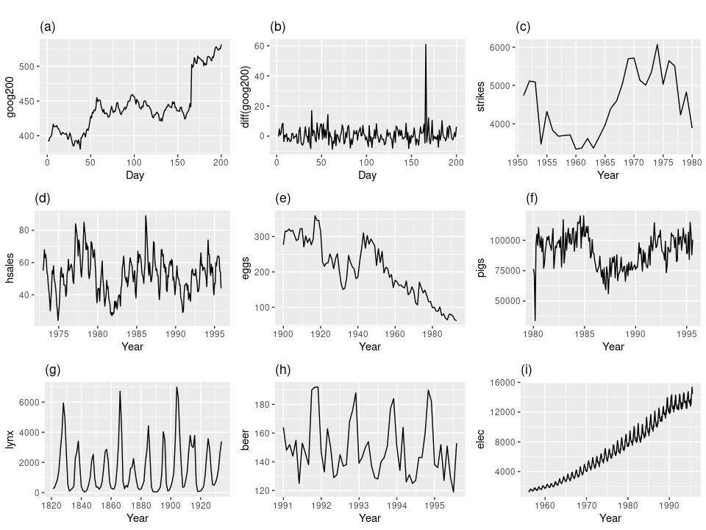

Which of these series are stationary?
No trends or seasons

Slide 5
ARIMA Model
An ARIMA model is characterized by 3 terms: p, d, q:
p is the order of the AR term
q is the order of the MA term
d is the number of differencing required to make the time series stationary
Predicted Y_{t} =
Constant
+ Linear combination Lags of Y
+ Linear Combination of Lagged forecast errors
Notes:
+ Linear combination Lags of Y (upto p lags) + Linear Combination of Lagged forecast errors (upto q lags)

Slide 6
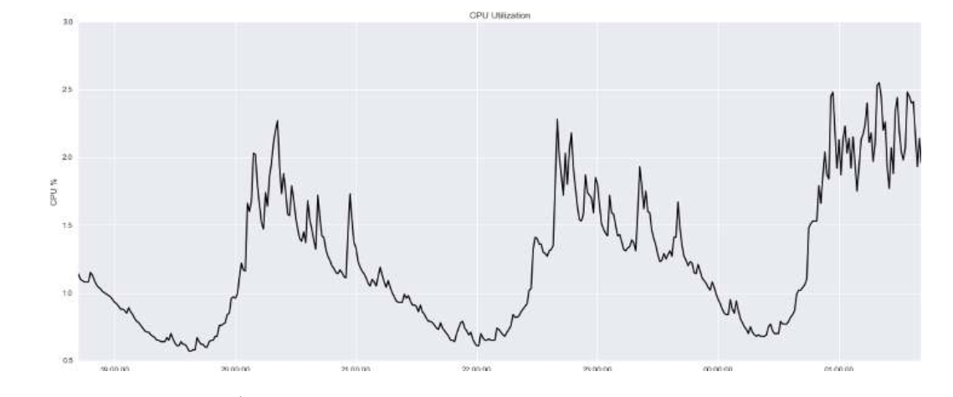
Example – CPU Utilization
Looks stationary
Perform anomaly detection on per-minute metrics of a host’s CPU utilization.
y-axis: the percentage CPU utilization
x-axis: time.
No trends or seasons

Slide 7

How to find the order of differencing (d) ?

Slide 8
Calculate the order of differencing (d)
smaller the p-value: means that evidences refuse the presence of null hypothesis.
A null hypothesis is a type of hypothesis used in statistics that proposes that there is no difference between certain characteristics of a population (or data-generating process).
If p-value > 0.05 -> you need to find differencing
Adf-fuller test: Perform a test of stationarity for different levels of d to estimate the number of differences required to make a given time series stationary, calculating the p-value.

Slide 9
Calculate the order of differencing (d)
from statsmodels.tsa.stattools import adfuller def adfuller_test(data): result=adfuller(data) labels = ['ADF Test Statistic','p-value','#Lags Used','Number of Observations'] for value,label in zip(result,labels): print(label+' : '+str(value) ) if result[1] <= 0.05: print("strong evidence against the null hypothesis(Ho), reject the null hypothesis. Data is stationary") else: print("weak evidence against null hypothesis,indicating it is non-stationary ") print('\n')

Slide 10
Calculate the order of differencing (d)
ADF Test Statistic : -3.3883046691878365
p-value : 0.011364084773593613
#Lags Used : 20
Number of Observations : 639
strong evidence against the null hypothesis(Ho), reject the null hypothesis. Data is stationary
import arima_utils arima_utils.adfuller_test(data['cpu'])
If p-value > 0.05 -> you need to find differencing
p-value: 0.011364
It is not required differencing!!!
No trends or seasons

Slide 11
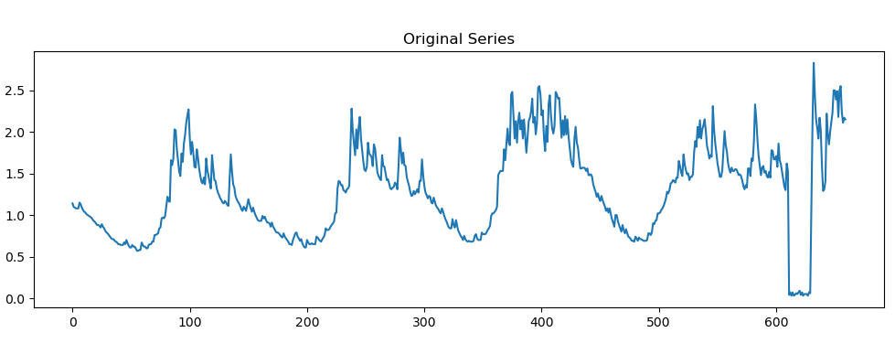
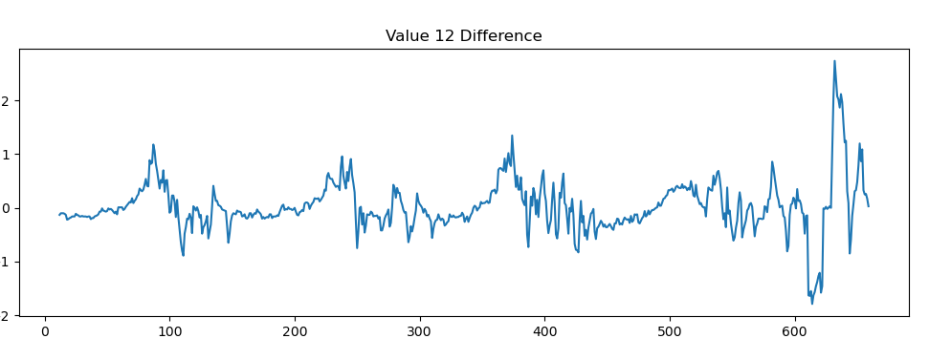
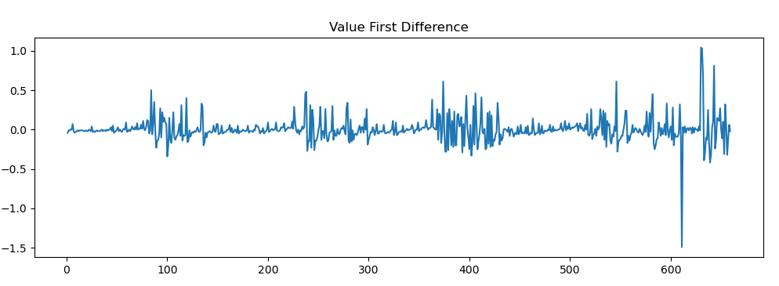
Calculate the order of differencing (d)

Slide 12
How to calculate the order of the AR term (p)?

Slide 13
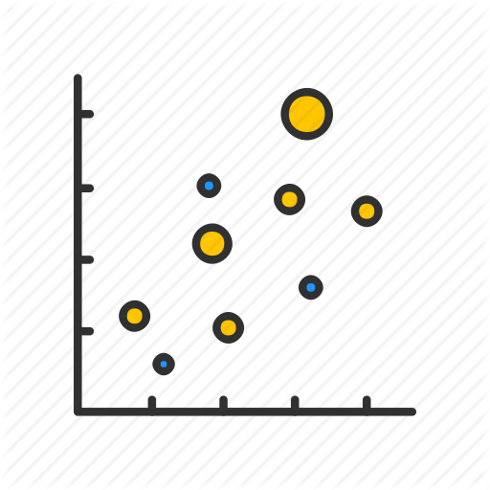
Calculate the order of the AR term (p)
The next step is to identify if the model requires any AR terms.
You can find out the required number of AR terms by inspecting the Partial Autocorrelation (PACF) plot.
Partial autocorrelation can be imagined as the correlation between the series and its lag, after excluding the contributions from the intermediate lags.

Slide 14
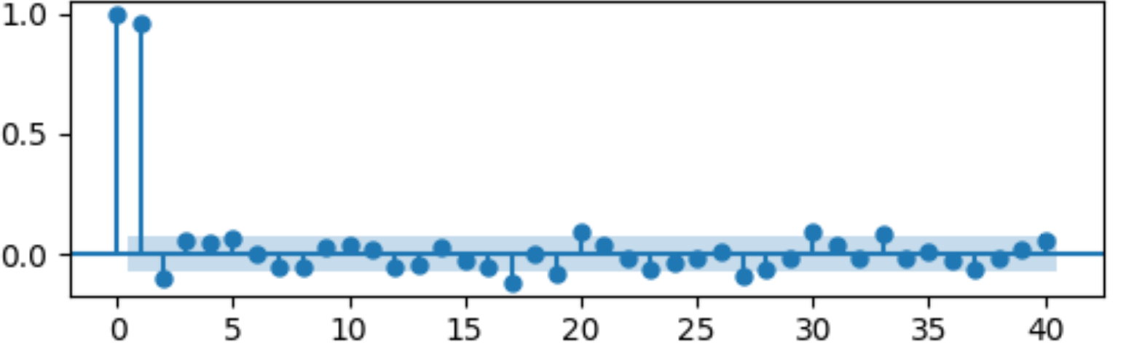
def plot_pacf(data): fig = plt.figure(figsize=(12, 8)) ax1 = fig.add_subplot(211) fig = sm.graphics.tsa.plot_pacf(data.dropna(), lags=40, ax=ax1) plt.show()
In the plot, look for points above the hatch area.
Using the plot, you can identify follows points: 22, 30, 33/34.
My suggestion is to use the smaller positive number; you reduce the calculation in the training phase.

Slide 15
How to find the order of the MA term (q)?

Slide 16
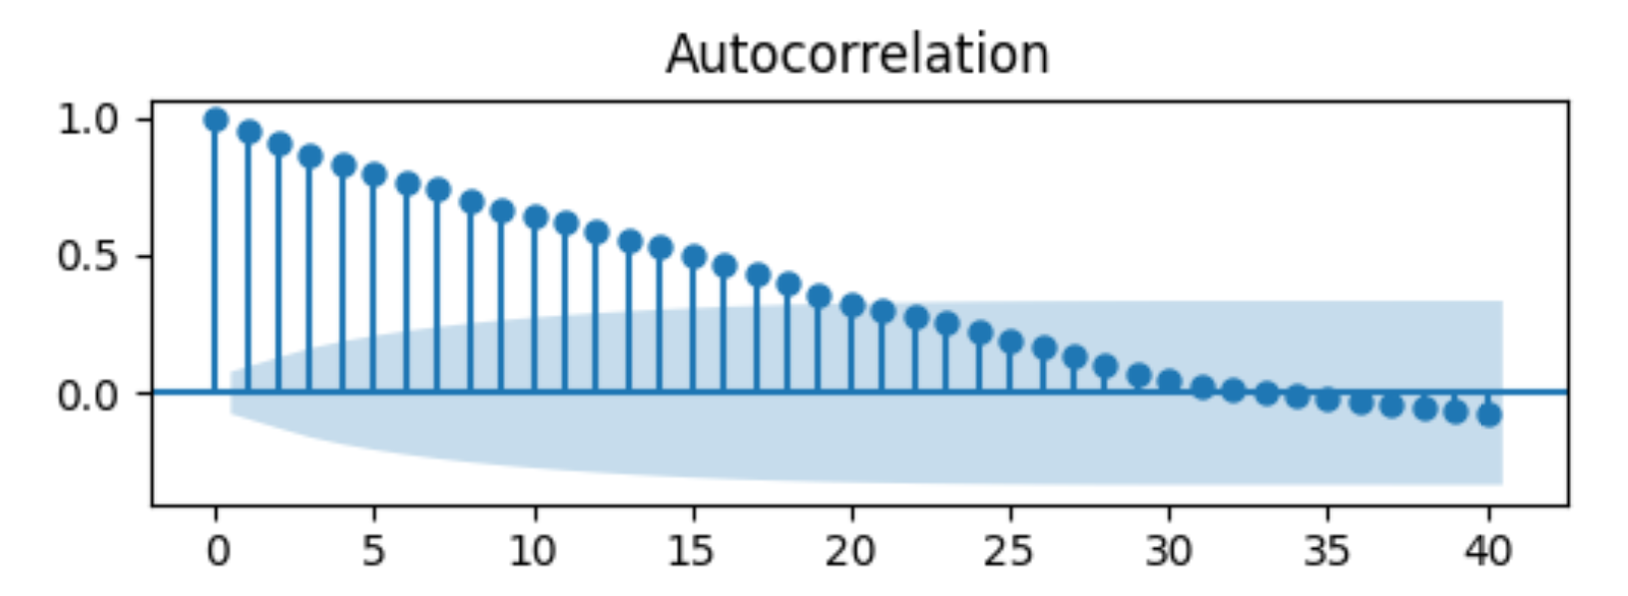
How to find the order of the MA term (q)?
The ACF tells how many MA terms are required to remove any autocorrelation in the stationarized series.
To calculate MA term (q), we analyze again the acf function plot.
In the plot, look for points above the hatch area.
The results are values between 1 to 17.
My suggestion is to use the smaller positive number; you reduce the calculation in the training phase.

Slide 17

Build ARIMA Model

Slide 18
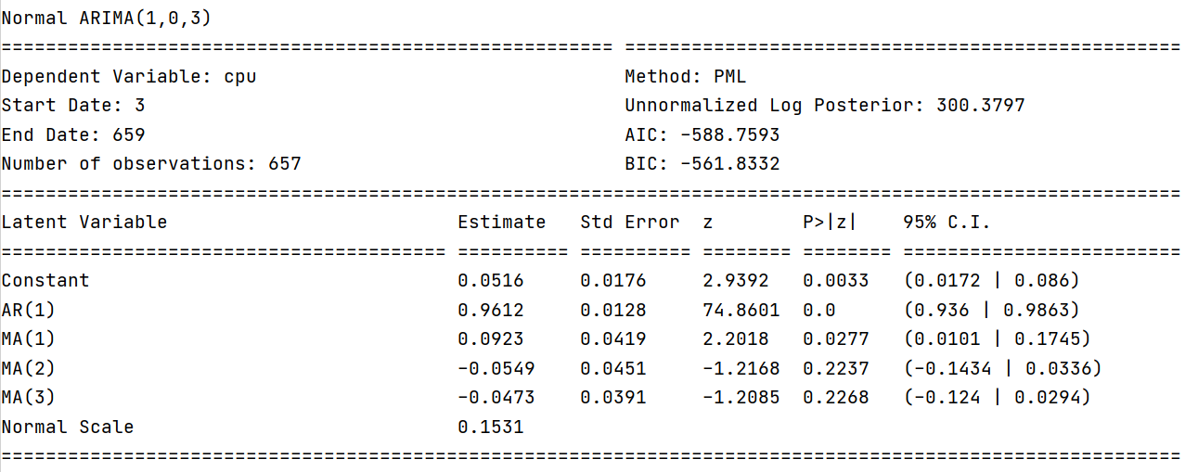
Training the model
Equation coeficients
model = pf.ARIMA(data=data, ar=1, ma=3, integ=0, target='cpu') x = model.fit("PML") print(x.summary())
Analyzing the summary's output, you need to check the p-values to AR(1) and MA(3). It works for the AR; however, it does not work for the MA.
ar=16, ma=10

Slide 19
Training the model
Check again te result and see that the good idea is to use 1, (MA(1) has p-value < 0.05).
Remember in the PACF plot it is the first suggestion of dataset.

Slide 20
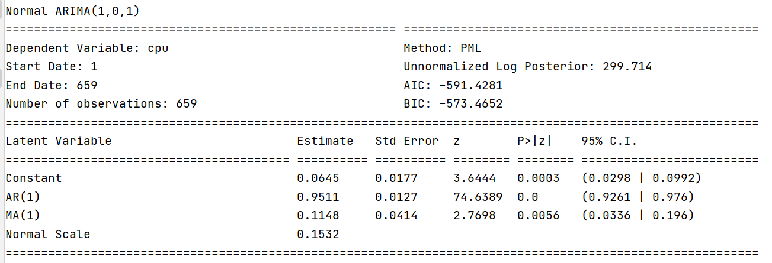
Training the model
Equation coeficients
model = pf.ARIMA(data=data, ar=1, ma=1, integ=0, target='cpu') x = model.fit("PML") print(x.summary())
Analyzing the summary's output, you need to check the p-values to AR(1) and MA(3). It works for the AR; however, it does not work for the MA.
ar=16, ma=10

Slide 21
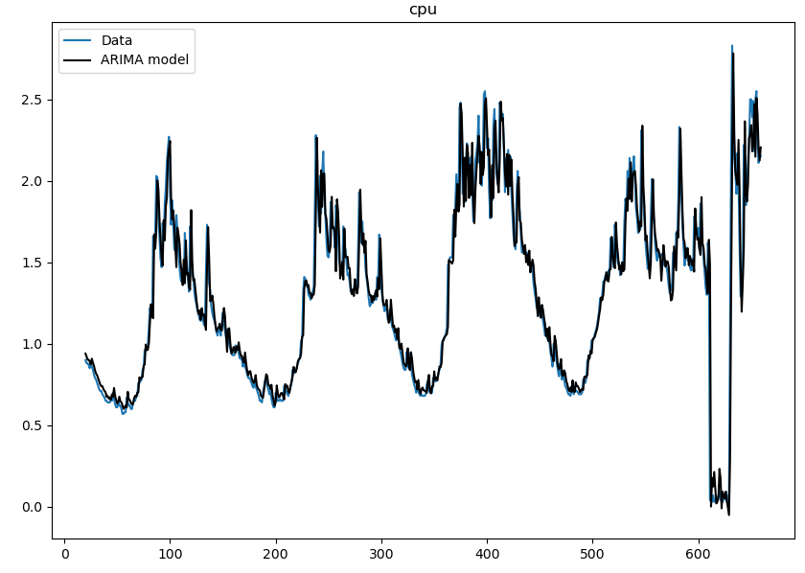
Test the predictions
model.plot_fit() plt.show()

Slide 22
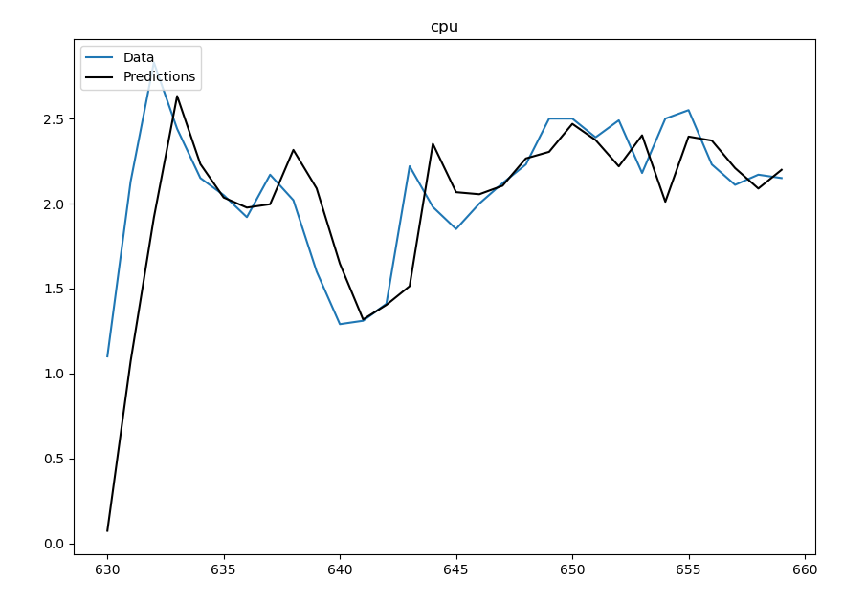
Test the predictions
Use the data that you have and see that predictions fit with the values that you have in the dataset.
h = How many steps to forecast ahead
model.plot_predict_is(h=30) plt.show()

Slide 23
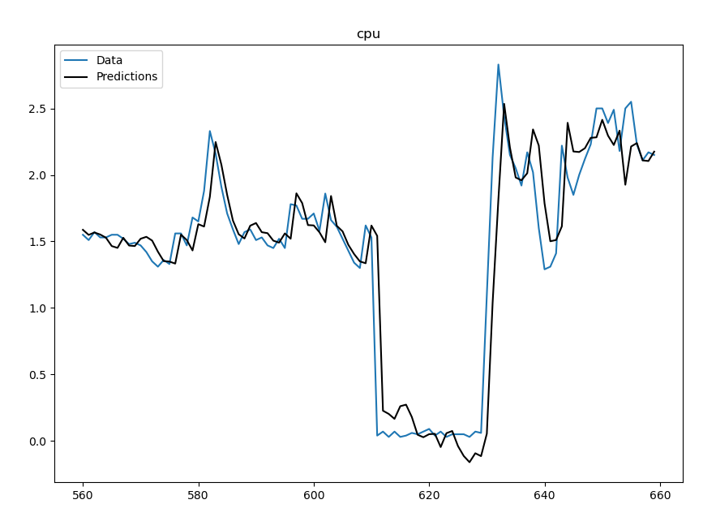
Test the predictions
model.plot_predict_is(h=100, past_values=40) plt.show()
past_values: How many past datapoints to plot

Slide 24
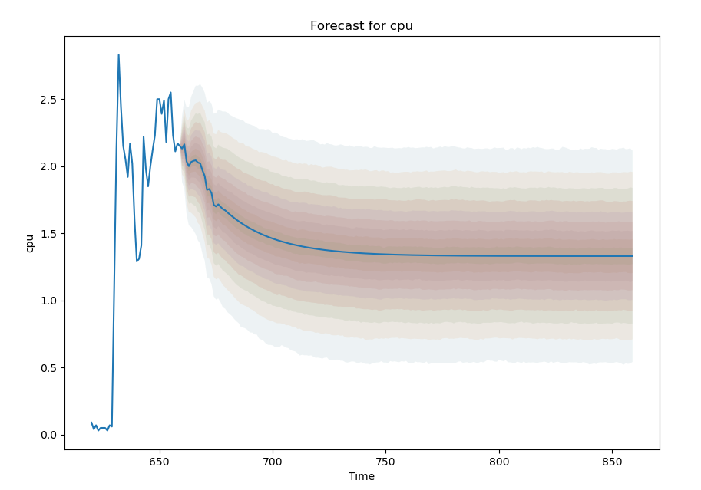
Making Predictions
#How many steps to forecast ahead model.plot_predict(h=200,past_values=40)

Slide 25
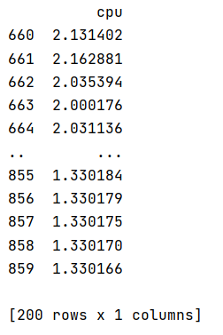
Making Predictions
#How many steps to forecast ahead fcast = model.predict(h=200) print(fcast)

Slide 26
Unit 3 – Anomaly Detection (2)
Outline
Review ARIMA Concepts
How to find the order of differencing (d) ?
How to calculate the order of the AR term (p)?
How to find the order of the MA term (q)?
Build ARIMA Model

Slide 27
Computational Intelligence (TC2023)

